Slide 1
Hoffman Stores Prediction
Varsha K
varshakrishna003@gmail.com

Slide 2
Content
● Problem Statement
● Data Summary
● Approach
● Exploratory Data Analysis
● Modeling:
- Decision Tree
Random Forest
Gradient boosting
- Random forest Hypertuning Parameters
● Model Performance and Evaluation
● Conclusion and Recommendations

Slide 3
PROBLEM STATEMENT
Hoffman operates over 3,000 drug stores in 7 countries. Hoffman store managers are currently tasked with predicting their daily sales up to six weeks in advance. Store sales are influenced by many factors, including promotions, competition, school, and state holidays, seasonality, and locality. With thousands of individual managers predicting sales based on their unique circumstances, the accuracy of results can be quite varied.
You are provided with historical sales data for 1,115 Hoffman stores. The task is to forecast the "Sales" column for the test set. Note that some stores in the dataset were temporarily closed for refurbishment.
DATA SUMMARY
Data 1- Columns- 9, Rows- 1017210 (sample- 50k-1 lakh)
Data 2 – Columns – 10, Rows – 1115
Note: We need a batch prediction as per store id (one day or multiple days it’s your discretion)

Slide 4
DATA DICTIONARY -1
Id - an Id that represents a (Store, Date) duple within the set
Store - a unique Id for each store
Sales - the turnover for any given day (Dependent Variable)
Customers - the number of customers on a given day
Open - an indicator for whether the store was open: 0 = closed, 1 = open
State Holiday - indicates a state holiday. Normally all stores, with few exceptions, are closed on state holidays. Note that all schools are closed on public holidays and weekends. a = public holiday, b = Easter holiday, c = Christmas, 0 = None
School Holiday - indicates if the (Store) was affected by the closure of public schools
Store Type - differentiates between 4 different store models: a, b, c, d
DATA DICTIONARY -1
Assortment - describes an assortment level: a = basic, b = extra, c = extended. An assortment strategy in retailing involves the number and type of products that stores display for purchase by consumers.
Competition Distance – the distance in meters to the nearest competitor store
Competition Open Since[Month/Year] - gives the approximate year and month of the time the nearest competitor was opened
Promo - indicates whether a store is running a promo on that day
Promo2 - Promo2 is a continuing and consecutive promotion for some stores: 0
= store is not participating, 1 = store is participating
Promo2 Since[Year/Week] - describes the year and calendar week when the store started participating in Promo2
Promo Interval - describes the consecutive intervals Promo2 is started, naming the months the promotion is started anew. E.g. "Feb, May, Aug, Nov" means each round starts in February, May, August, and November of any given year for that store.

Slide 5
APPROACH
Data Collection and Preprocessing - Importing important libraries and modules - Data Cleaning - Missing Data Handling - Merging the Datasets
Exploratory Data Analysis - Categorical Features - Continuous Features - EDA Conclusion
Feature Selection and Outlier Detection - Feature Engineering - Outlier Detection and Treatment
Modeling - Train Test Split - Decision Tree - Random Forest Model - Random Forest Hyperparameter Tuning – Gradient Boosting Regressor
Model Performance and Evaluation
Conclusion and Recommendations

Slide 6
Exploratory Data Analysis
Importing the packages and dataset. Checking out the features and shape of the dataset .
1. Random Sampling
As I could the dataset has very large amount of data (1017209,9). It may take time to perform. By using Random Sampling technique picking out the data in the range between 50000 to 1 Lakh row .
Reduced the data to 61063 rows x 9 columns.
2. Missing values
The sales dataset does not have any NULL values.
The store dataset has NULL Values. missing values in CompetitionDistance,CompetitionOpenSinceMonth ,CompetitionOpenSinceYear,Promo2SinceWeek ,Promo2SinceYear ,PromoInterval

Slide 7
Out of 1115 entries there are missing values for the columns:
CompetitionDistance- distance in meters to the nearest competitor store, the distribution plot would give us an idea about the distances at which generally the stores are opened and perform MEDIAN as it also have outliers and right skewed.
CompetitionOpenSinceMonth- gives the approximate month of the time the nearest competitor was opened, mode of the column would tell us the most occuring month
CompetitionOpenSinceYear- gives the approximate year of the time the nearest competitor was opened, mode of the column would tell us the most occuring month
Promo2SinceWeek, Promo2SinceYear and PromoInterval are NaN wherever Promo2 is 0 or False as can be seen in the first look of the dataset. They can be replaced with 0.
3. Merging the two Datasets on the basis of STORE feature
4. Extracting new feature year, month, week of year, day of year with DATE feature

Slide 8
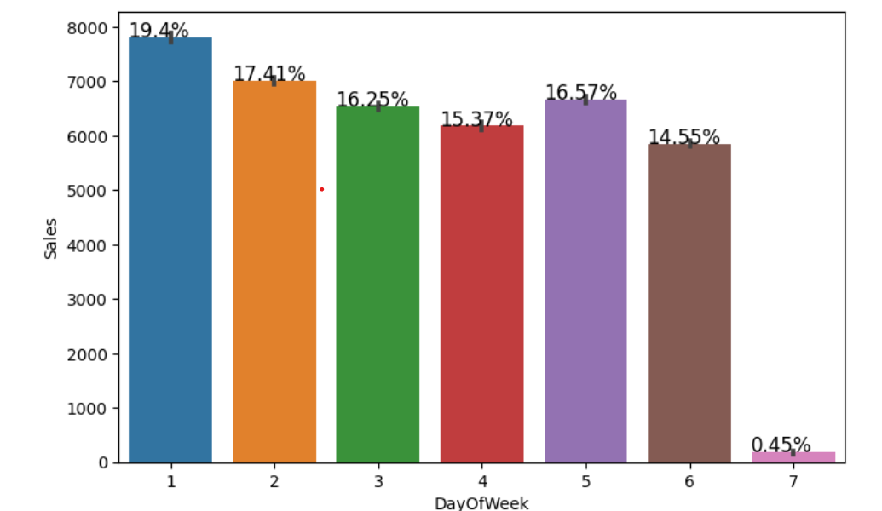
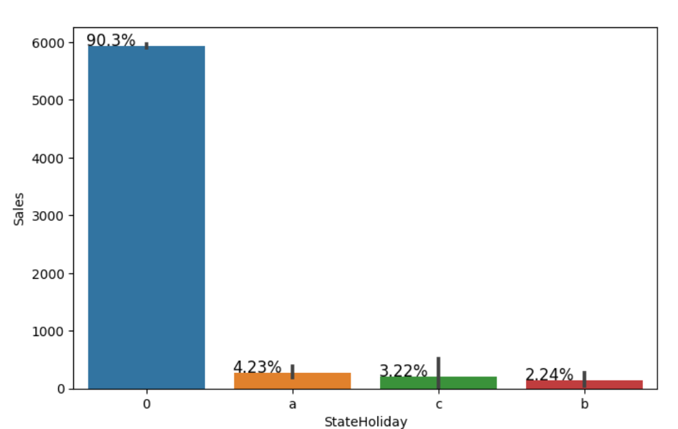
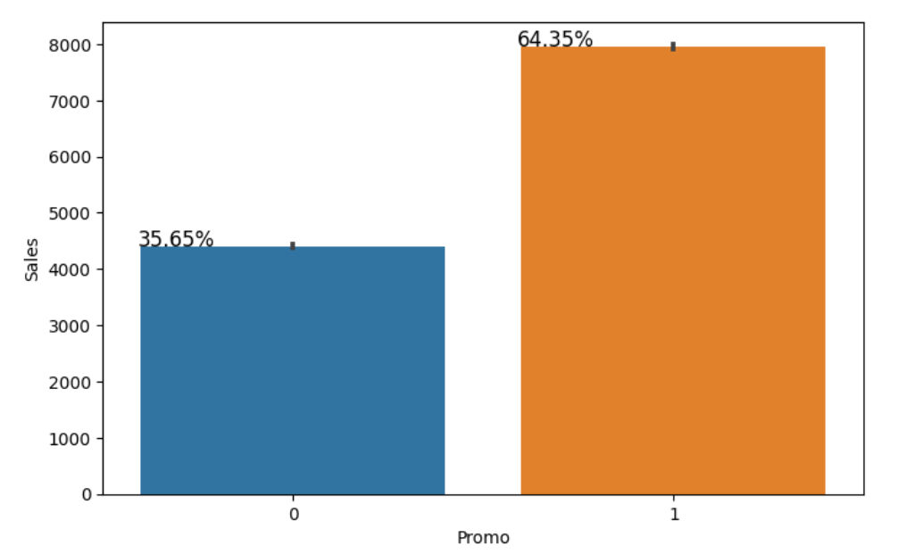
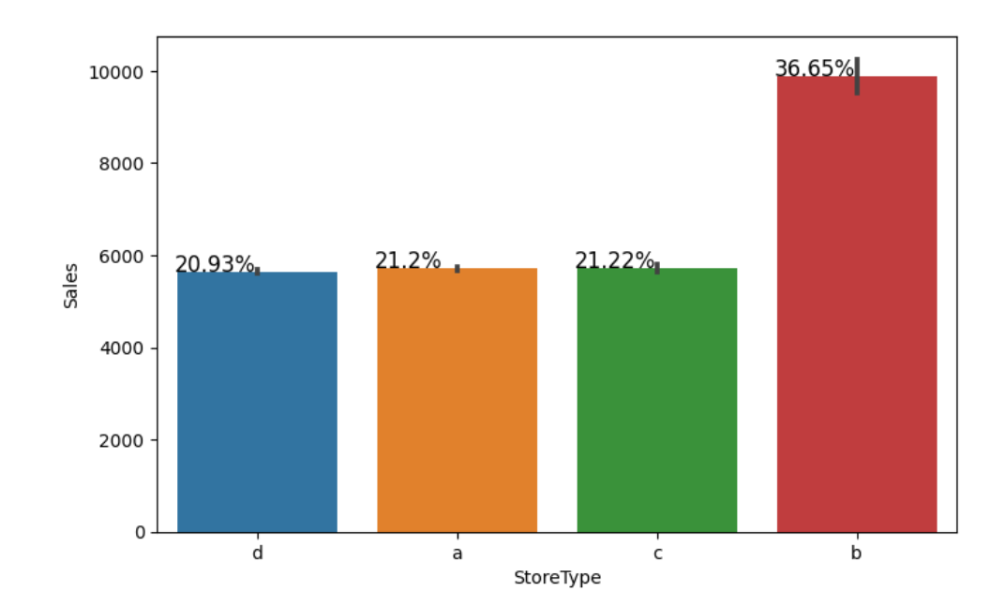
5.barplots of the categorical variables against sales

Slide 9

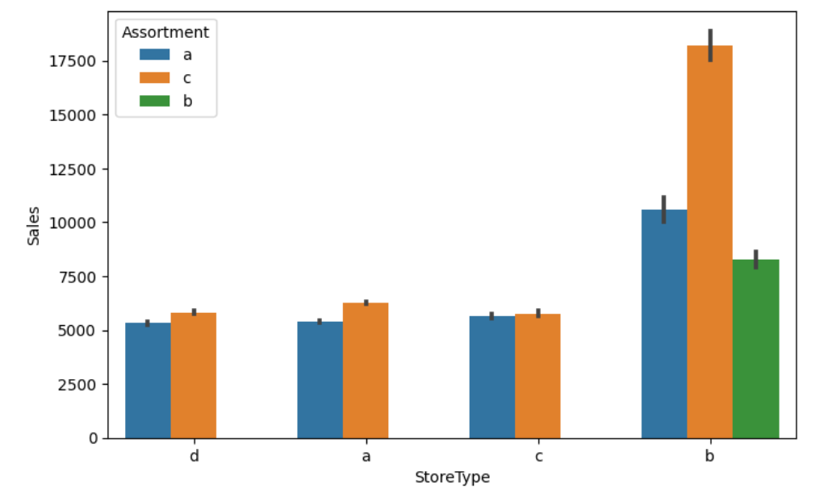
Observations :
There were more sales on Monday, probably because shops generally remain closed on Sundays.
Normally all stores, with few exceptions, are closed on state holidays. Note that all schools are closed on public holidays and weekends. a = public holiday, b = Easter holiday, c = Christmas, 0 = None. Lowest of Sales were seen on state holidays especially on Christmas.
More stores were open on School Holidays than on State Holidays and hence had more sales than State Holidays.
On an average Store type B had the highest sales.
Highest average sales were seen with Assortment levels-b which is 'extra'.
With Promo2, slightly more sales were seen without it which indicates there are many stores not participating in promo.
The number of shops open on Sundays were very less and hence low sales. Some shops were closed on weekdays as well accounting to the stores closed due to refurbishment or holidays.
The above bar plot shows that the store types a, c and d have only assortment level a and c. On the other hand the store type b has all the three kinds of assortment strategies, a reason why average sales were high for store type b stores.

Slide 10
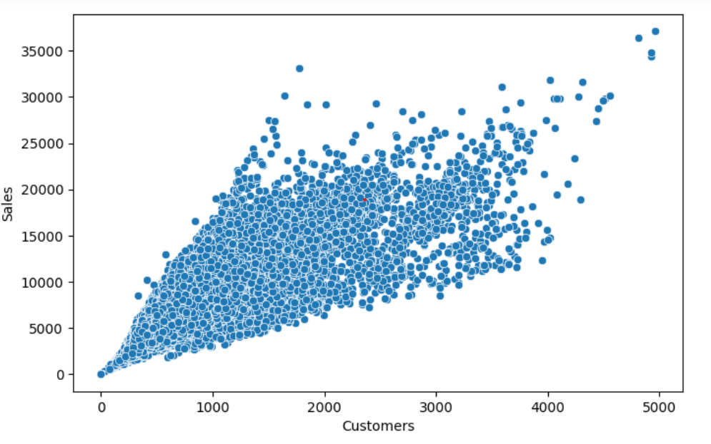
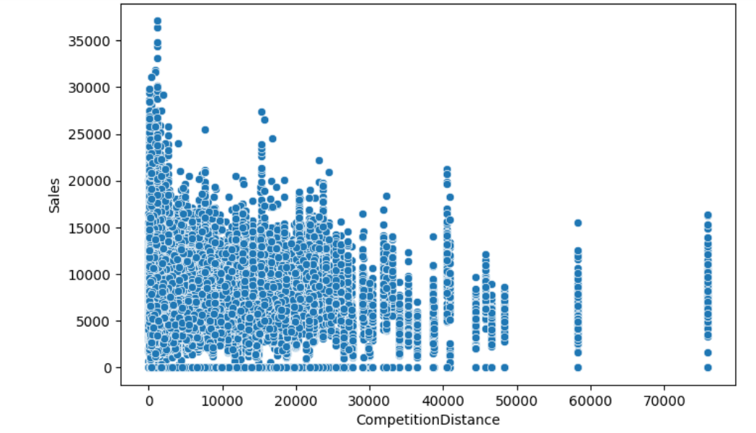
positive correlation between customers and sales. There are a few outliers.
competition distance within the range of 0 to 10 kms and had more sales than stores far
away.

Slide 11
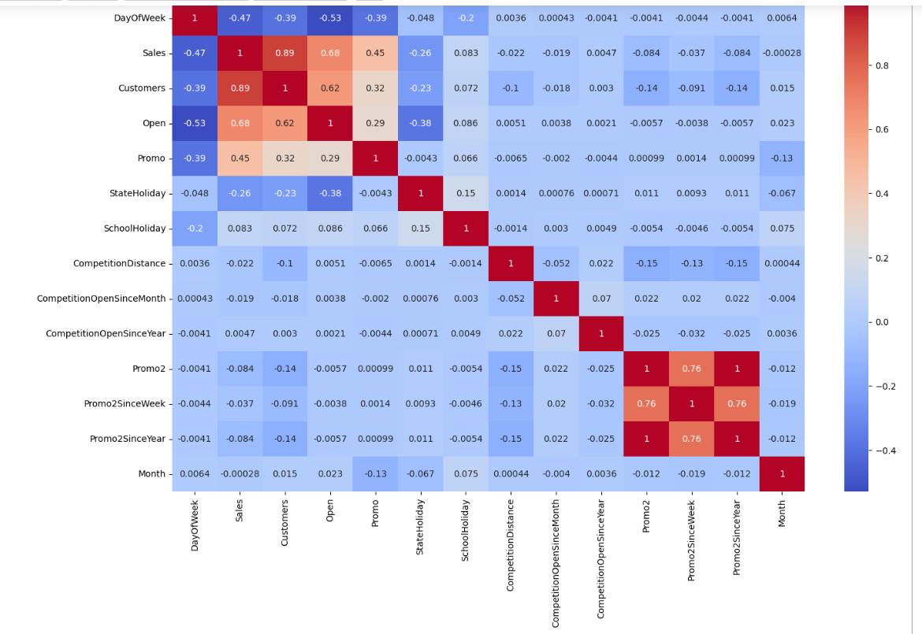
Observation:
Day of the week has a negative correlation indicating low sales as the weekends, and promo, customers and open has positive correlation.
State Holiday has a negative correlation suggesting that stores are mostly closed on state holidays indicating low sales.
CompetitionDistance showing negative correlation suggests that as the distance increases sales reduce, which was also observed through the scatterplot earlier.
There's multicollinearity involved in the dataset as well. The features telling the same story like Promo2, Promo2 since week and year are showing multicollinearity.
The correlation matrix is agreeing with all the observations done earlier while exploring through barplots and scatterplots.

Slide 12
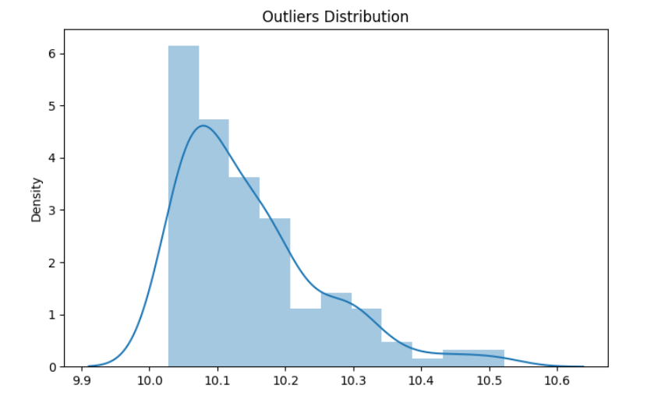
OUTLIERS
Observation:
DayOfWeek for Store 262. It's sunday and it has high sales and it's of the store type B.
All other data points had promotion going on and they had a high number of Customers as well indicating no absurd behavior.
It can be well established that the outliers are showing this behavior for the stores with promotion = 1 and store type B.
The outliers are a valid occurrence so not treating them by deleting or manipulating. It is well established that there is seasonality involved and no linear relationship is possible to fit. For these kinds of datasets tree based machine learning algorithms are used which are robust to outlier effect.

Slide 13
MODELING :
● A multivariate time series relation with sales and hence a linear relationship cannot be
assumed in this analysis. This kind of dataset has patterns such as peak days, festive
seasons etc which would most likely be considered as outliers in simple linear regression.
● Having X columns with 30% continuous and 70% categorical features. Business prefers the
model to be interpretable in nature and decision based algorithms work better with
categorical data.
Performed Train-Test Split and scaled down the values .
MODELS
Decision Tree Regressor
Random forest Regressor
Gradient Boosting regressor
EVALUATION METRICES
Mean Absolute Error
Mean Squared Error
Root Mean Squared Error
R^2
Adjusted R^2

Slide 14
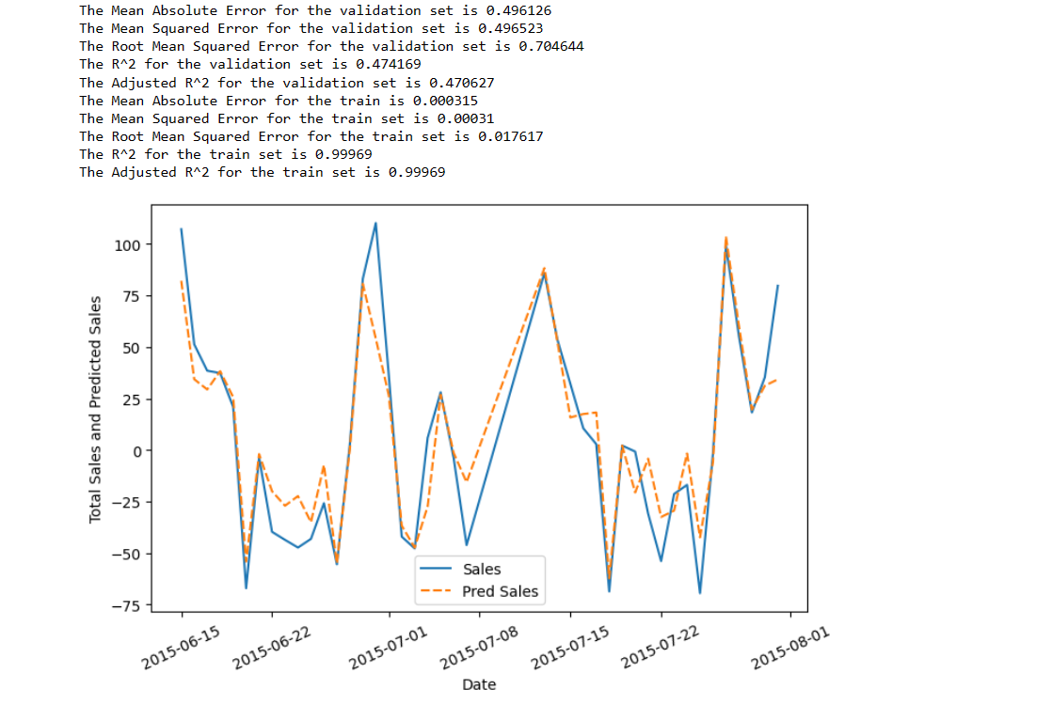
DECISION TREE REGRESSOR

Slide 15
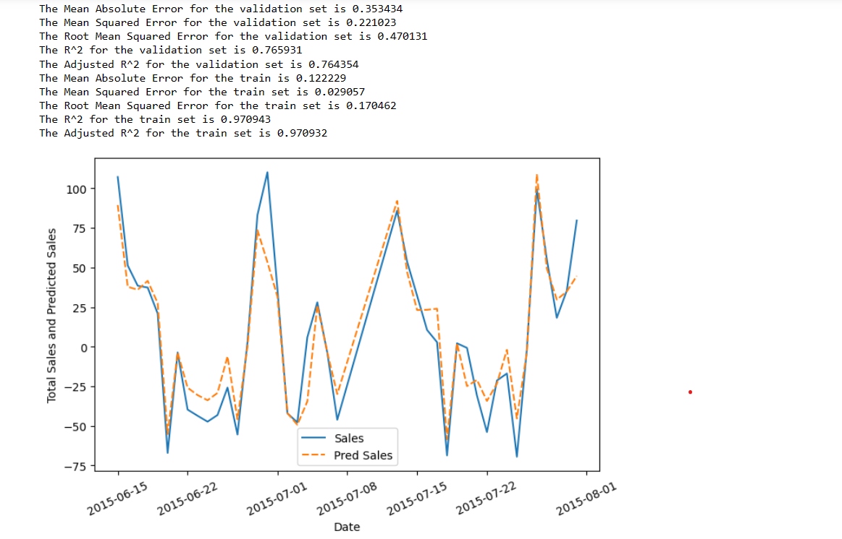
RANDOM FOREST REGRESSOR

Slide 16
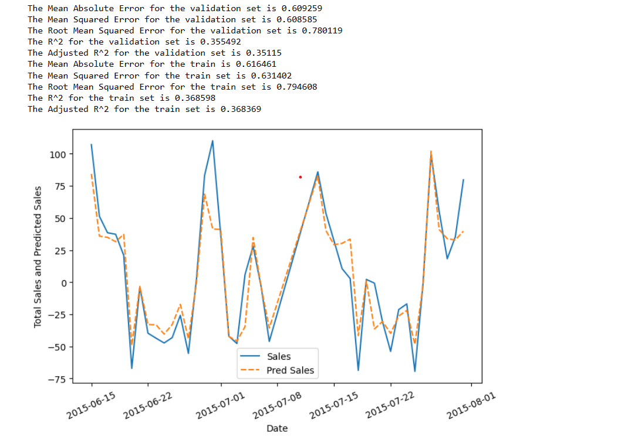
Gradient boosting regressor

Slide 17
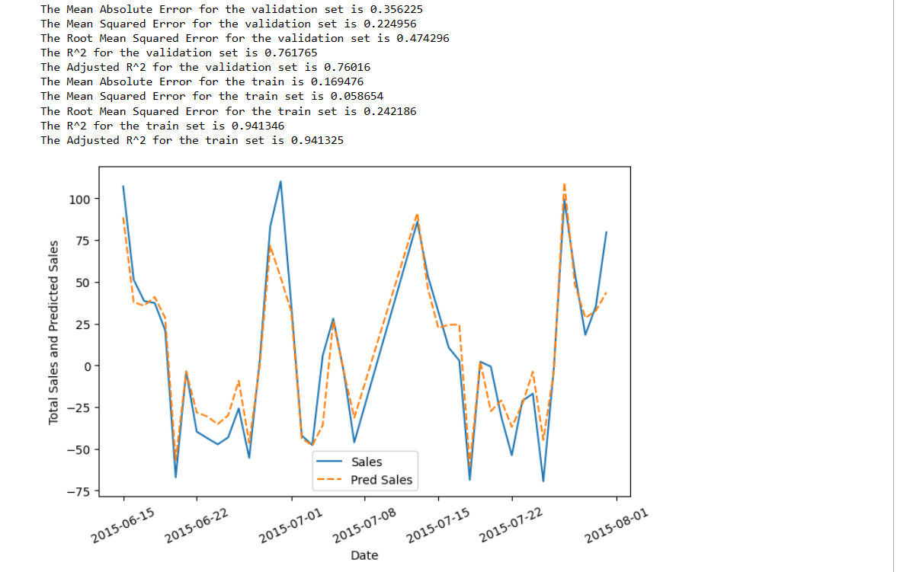
Random Forest Regressor results were much better than other model with a
test R^2 of 0.765931 and lower value of MAE , MSE and RMSE()
Random Forest Hyperparameter Tuning:

Slide 18
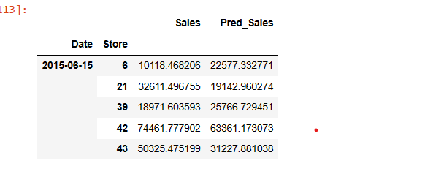
Store wise Sales Predictions
Total prediction submission:
https://drive.google.com/file/d/1zOgVkQ_Ql6wT5EuLJXANuawiBhTytyyg/view?usp=drive_link

Slide 19

CONCLUSION :
In conclusion, the Hoffmann sales prediction model achieved a high R-squared value by using Random forest Regressor . The model demonstrated strong predictive capabilities, accurately forecasting sales with minimal error. This suggests that the model can effectively assist in sales forecasting and decision-making for the Rossman stores.

